Slide 1
Complex Integration

Slide 2
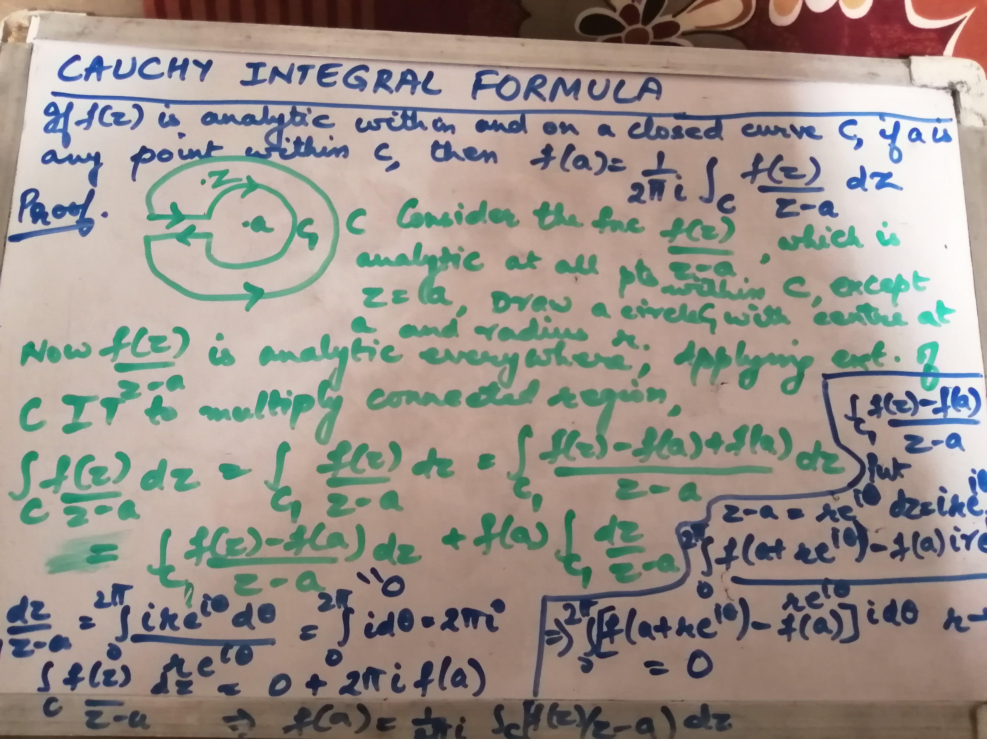

Slide 3
