Slide 1
Subject : Bengali
Course : B.A. Prog.
Teachers Name : Dr. Antara Chaudhuri
Semester : II
Paper : Functional Grammar of the Language

Slide 2
Functional Grammar of the Language

Slide 3
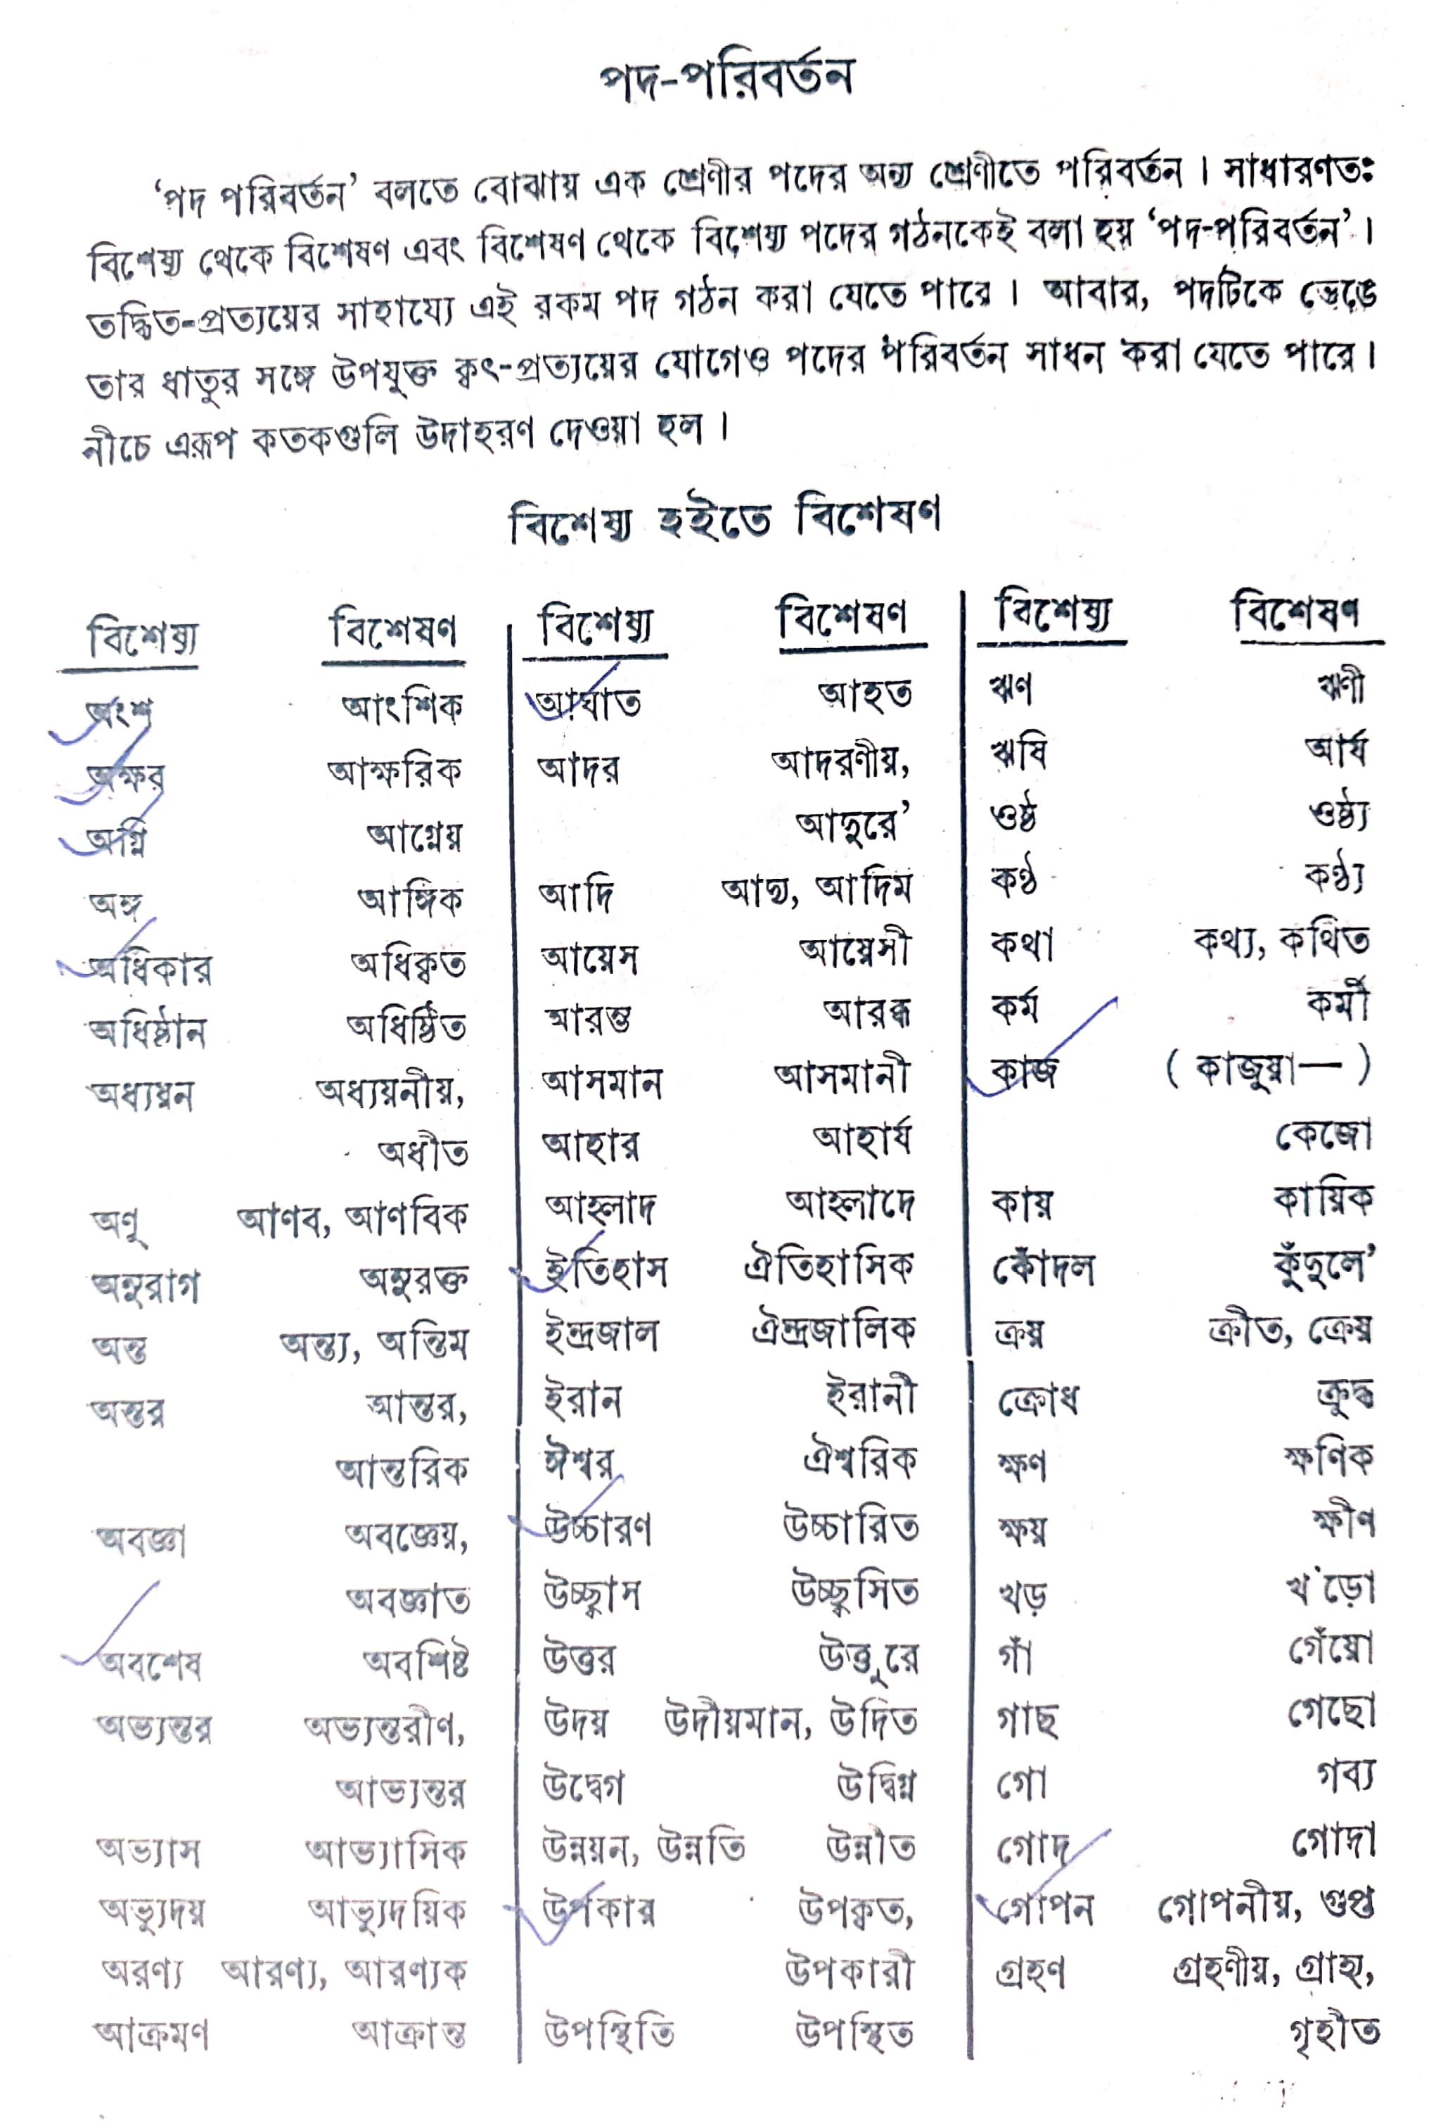

Slide 4
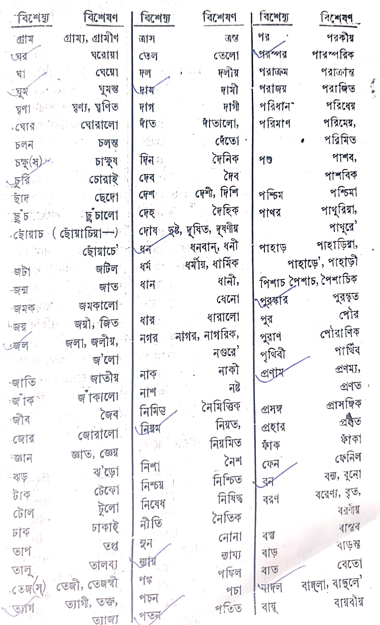

Slide 5
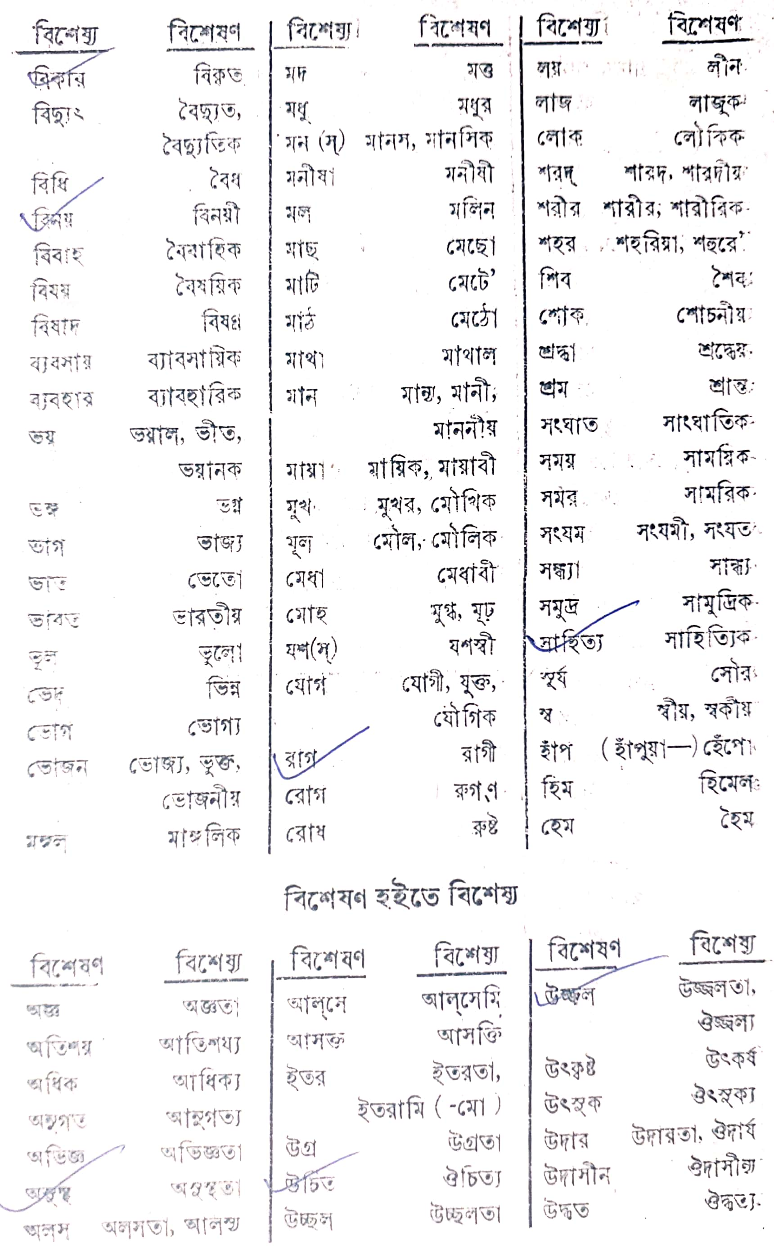

Slide 6
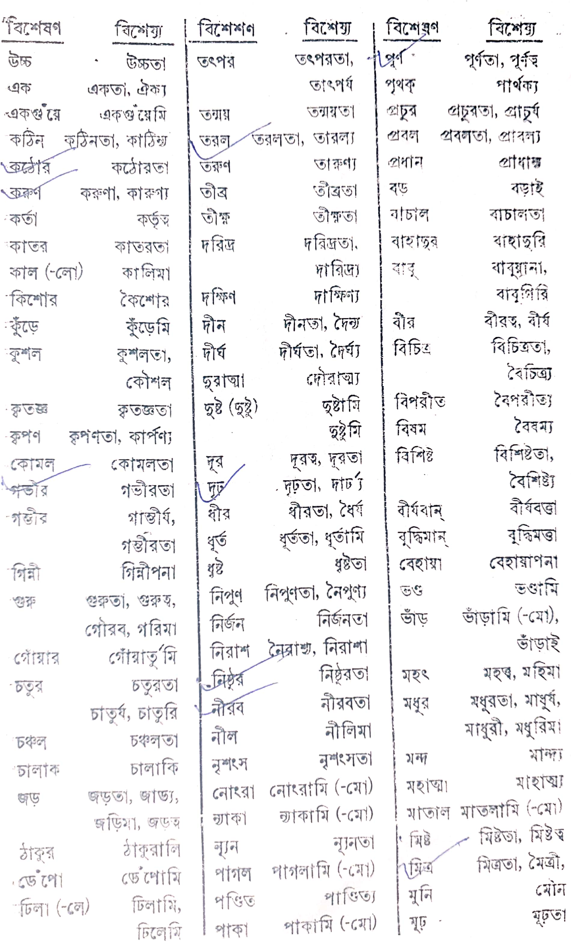

Slide 7
